Slide 1
Machine Learning KNN
Jay Urbain, PhD

Slide 2
Topics
What is machine learning?
Supervised learning
Unsupervised learning
Classification with K-Nearest Neighbors

Slide 3
Data Science Process
Ask questions – hypothesize
Data collection
Data exploration
Data modeling
Evaluation
Visualization of results

Slide 4
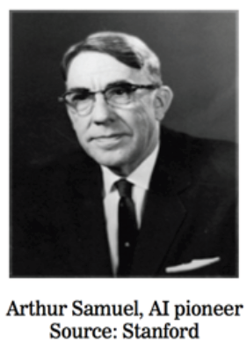
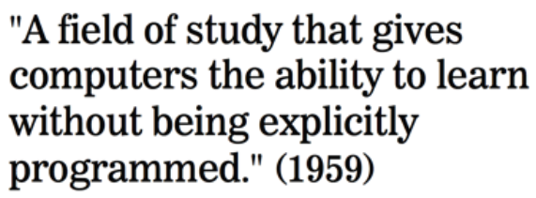
What is machine learning?

Slide 5
What is machine learning?
Machine Learning is a class of algorithms which are data-driven. Unlike classical algorithms, it is the data that defines a “good” answer.
Example:
A Non-Machine Learning algorithm might “define” a face as having a roundish structure, two eyes, hair, nose, etc. The algorithm then looks for these “hard-coded” features in test cases.
A Machine Learning algorithm might only be given several pictures of faces and non-faces that are labeled as such. From the examples (called training set) it would “figure out” it’s own definition (model) of a face.

Slide 6


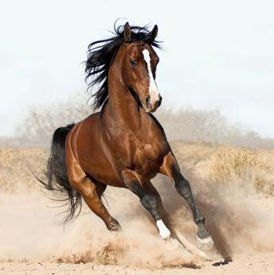
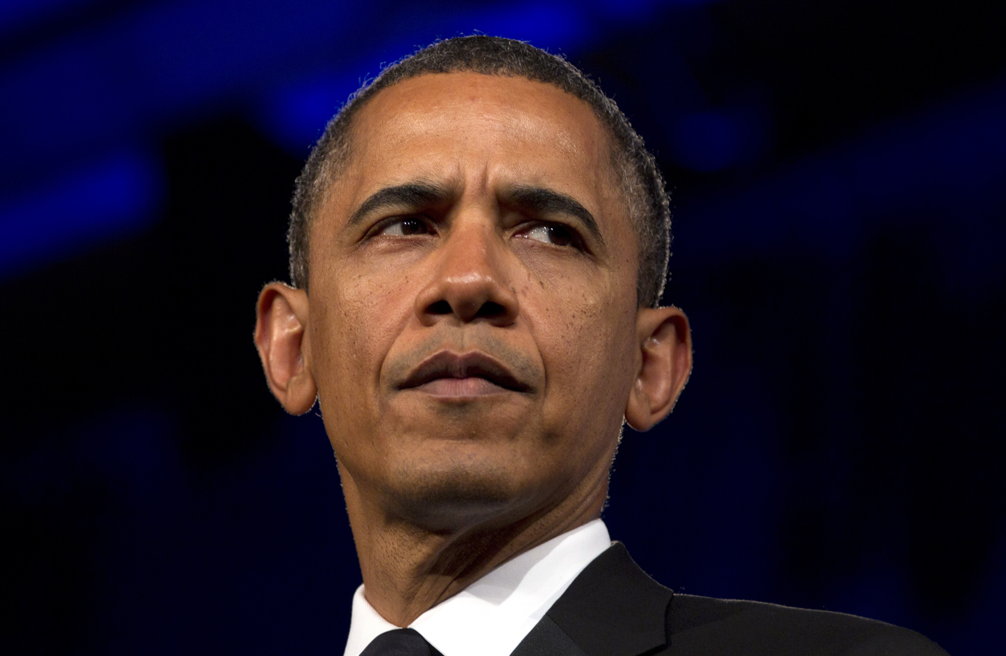
Example: Facial Recognition: Machine Learning
Test
Training set
Face
Face?
Not Face
Face
The core of machine learning deals with representation and generalization…

Slide 7
Types of Machine Learning Problems
generalization
supervised making predictions
unsupervised extracting structure
reinforcement achieve goals
representation
Supervised: labeled data
Unsupervised: unlabeled data
Reinforcement: goal, feedback
policy

Slide 8
Supervised learning
Vector (list) of “Predictors” X
Also known as features, independent variables, inputs, regressors, covariates, attributes
“Response” y
Also known as outcome, label, target, dependent variable
If y is continuous: Regression
e.g., price, blood pressure
If y is categorical (values in a finite, unordered set): Classification
e.g., spam/ham, digit 0-9, cancer class of tissue sample
Data is composed of “observations” (predictors and the associated response)
Also known as samples, examples, instances, records

Slide 9
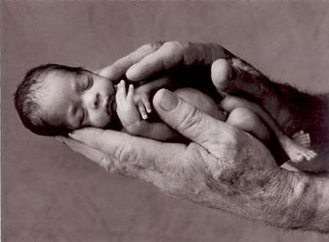
Example: Predicting neonatal infection
Problem: Children born prematurely are at high risk of developing infections, many of which are not detected until after the baby is sick
Goal: Detect subtle patterns in the data that predicts infection before it occurs
Data: 16 vital signs such as heart rate, respiration rate, blood pressure, etc…
Impact: Model is able to predict the onset of infection 24 hours before the traditional symptoms of infection appear
predictors
Sample response: Did the child develop an infection? True/False
Notes:
Lots of names you’d expect (also obama, nyt → politics = growth area)
Q: can you think of any others? → show some example in the browser
Soon the question will be: who doesn’t use data science?

Slide 10
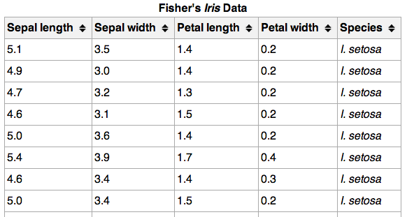
Supervised learning
150 observations
(n = 150)
4 predictors (p = 4)
response

Slide 11
Supervised learning
Supervised Learning uses known (labeled) “training cases” in order to:
Accurately predict unseen test cases
Understand which predictors affect the response, and how to
Assess the quality of our predictions

Slide 12
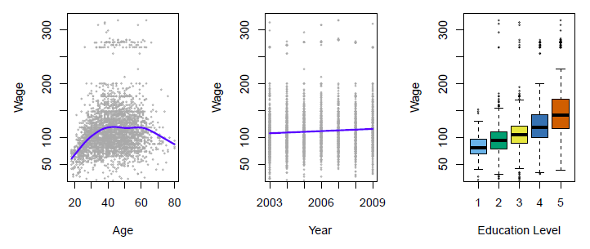
Supervised learning: regression example
Establish the relationship between salary and demographic variables in population survey data
Income survey data for males from the central Atlantic region of the USA in 2009
Source: https://class.stanford.edu/c4x/HumanitiesScience/StatLearning/asset/introduction.pdf

Slide 13
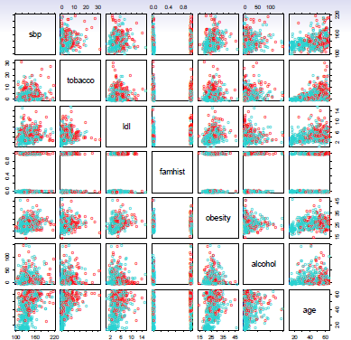
Supervised learning: classification example
Predict whether someone will have a heart attack on the basis of demographic, diet and clinical measurements
Case-control sample of men from South Africa
Red = heart disease
Blue = no heart disease
Source: https://class.stanford.edu/c4x/HumanitiesScience/StatLearning/asset/introduction.pdf

Slide 14
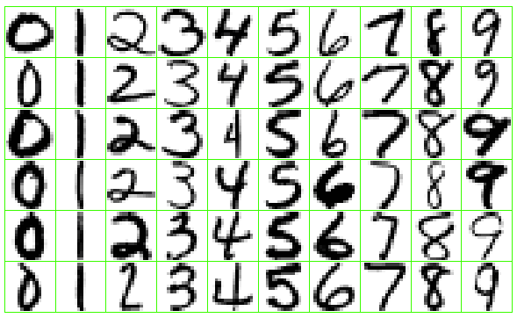
Supervised learning: classification example
Identify the numbers in a handwritten zip code
Source: https://class.stanford.edu/c4x/HumanitiesScience/StatLearning/asset/introduction.pdf

Slide 15
Unsupervised learning
No response variable y, just a set of predictors X
Objective is more open:
Find groups of observations that behave similarly
Find predictors that behave similarly
Find combinations of features that explain the variation in the data
Difficult to evaluate how well you are doing
Data is easier to obtain for unsupervised learning since it can be “unlabeled” (i.e., it hasn’t been labeled with a response)
Sometimes useful as a preprocessing step for supervised learning
Common techniques: clustering, PCA, LDA, embeddings.

Slide 16
Supervised vs. unsupervised learning
continuous categorical
supervised regression classification
unsupervised dimensionality/ clustering
reduction

Slide 17
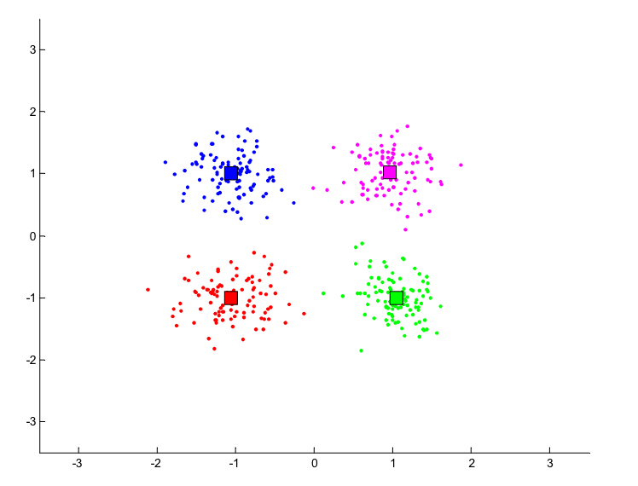
Clustering example
Source: http://people.cs.pitt.edu/~milos/courses/cs2750-Spring03/lectures/class17.pdf

Slide 18
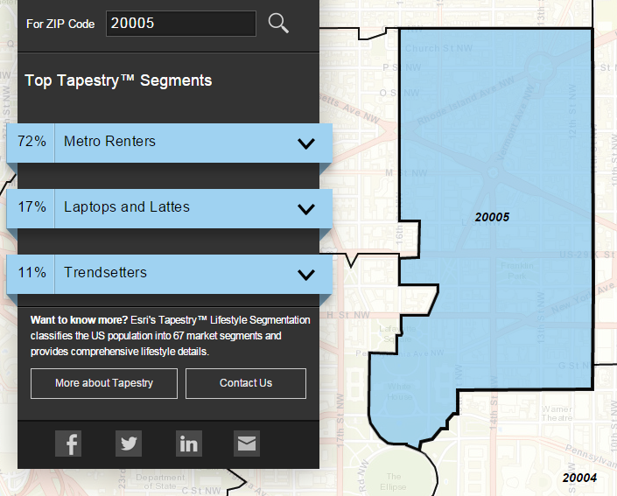
Clustering example
Classify US residential neighborhoods into 67 unique segments based on demographic and socioeconomic characteristics
Example of cluster: Metro Renters:
Young, mobile, educated, or still in school
Live alone or with a roommate
Works long hours
Buys groceries at Whole Foods and Trader Joe’s
Shops at Banana Republic, Nordstrom, and Gap
Loves yoga, go skiing, and attend Pilates sessions.
Source: http://www.esri.com/landing-pages/tapestry/

Slide 19
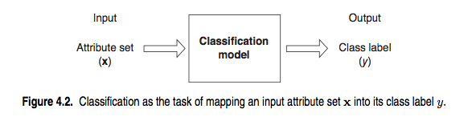
Classification problem
Q: How does a classification problem work?
A: Data in, predicted labels out.
function
Source: http://www-users.cs.umn.edu/~kumar/dmbook/ch4.pdf

Slide 20
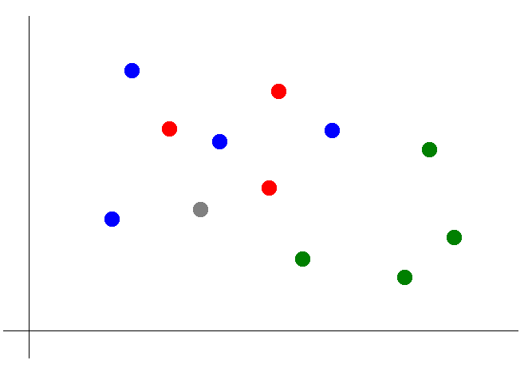
Classification with KNN
Suppose we want to predict the color of the gray dot.
What are the predictors?
What is the response?

Slide 21
Classification with KNN
Suppose we want to predict the color of the gray dot.
Pick a value for k.
k = 3

Slide 22
Classification with KNN
Suppose we want to predict the color of the gray dot.
Pick a value for k.
Find colors (classifications) of k nearest neighbors.
k = 3

Slide 23
Classification with KNN
Suppose we want to predict the color of the gray dot.
Pick a value for k.
Find colors (classifications) of k nearest neighbors.
Assign the most
common (mode) color
to the gray dot.
k = 3
Note: nearest is defined by a distance function, e.g., Euclidean distance based on predictors

Slide 24
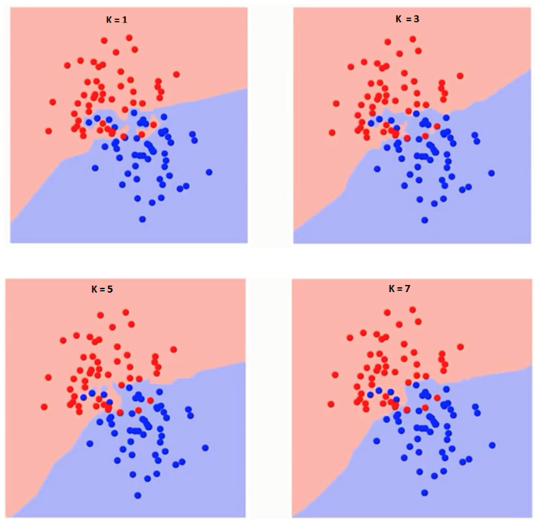
Picking a value for K
K value determines decision boundary.
Decision boundary becomes smoother as k is increased. Less likely to overfit.
Increasing K to infinity will set all values to either red or blue

Slide 25
Training vs. Validation
Blue – training error
Red – validation error
Note:
At k=1 you are overfitting the boundary
K eventually decreases until you get a minima.

Slide 26
Pseudo Code of KNN
Load the data
Initialize the value of k
For getting the predicted class, iterate from 1 to total number of training data points
Calculate the distance between test data and each row of training data. E.g., Euclidean distance, Chebyshev, cosine, etc.
Sort the calculated distances in ascending order based on distance values
Get top k rows from the sorted array
Get the most frequent class of these rows
Return the predicted class

Slide 27
KNN with scikit-learn
from sklearn.neighbors import KNeighborsClassifier
neigh = KNeighborsClassifier(n_neighbors=3)
neigh.fit(data.iloc[:,0:4], data['Name'])
# Predicted class
print(neigh.predict(test))
-> ['Iris-virginica']
# 3 nearest neighbors
print(neigh.kneighbors(test)[1])
-> [[141 139 120]]

Slide 28
Classification with KNN
Advantages of KNN:
Simple to understand and explain
Model training phase is fast
Non-parametric (does not presume a “form” of the “decision boundary”)
Disadvantages of KNN:
Prediction phase can be slow when n is large
Sensitive to irrelevant features

